Slide 1

COLLEGE INFORMATION BANK
One stop place for college selection
V. Harshita 1602-20-737-134
D.Lakshmi Bhavani 1602-20-727-141
K. Nidish 1602-20-737-147

Slide 2
PROBLEM STATEMENT
All India Council for Technical Education (AICTE).
There are more than 1000 universities in India and these universities are offering thousands of undergraduate, post-Graduate and doctorate courses. The students applying for these universities have to do a lot of comparison for choosing the university/course on the basis of various criteria’s. A PAN India university information bank is required for accessing course details, comparison of courses, facilities and faculty, admission, tracking student mobility, viewing results, evaluation and certification, verification of certificates, joint online courses (MOOCs). This will help both student and faculty communities for self improvement through comparison and emulations. Lack of information is leading to self glorification and inbreeding among University and College student and faculty members.

Slide 3

ABSTRACT
Integrated information platform for information about Universities
The universities provide various courses on different disciplines and the students have to compare these courses on the basis of various parameters. The integration of these details on a single platform will enhance the transparency and remove difficulty being faced by the students due to lack of information. To provide the students facility of applying to multiple colleges through a single application form and to assist them through chatbot.

Slide 4



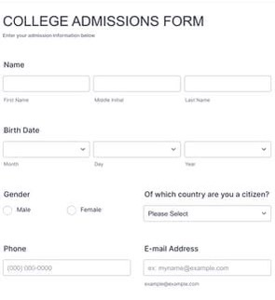
FEATURES
Compare selected
colleges
Chatbot
Sorting
packages/
NIRF ranking
Form

Slide 5
A T A
HARDWARE REQUIREMENTS:-
Intel core i5 processor
1 GB RAM
SOFTWARE REQUIREMENTS:-
Xampp
Visual studio code
PhpMyAdmin
Dialog flow
TEXT EDITOR:-
Visual Studio Code
FRONT END:-
Html
CSS
JavaScript
REQUIREMENTS

Slide 6
ALGORITHMS USED
SORT : mechanism like class “sortable” which is present in javascript is used for sorting data table with orderdata method based upon their average packages, the details are placed in html tables, user can search for equired college, compare colleges and also can know all the details about the college efficiently and clearly.
MAIL TO FUNCTION
DIALOG FLOW

Slide 7
DEPENDENCIES:
HEAVY DATABASE
To Collect authentic information about colleges and their accreditations

Slide 8
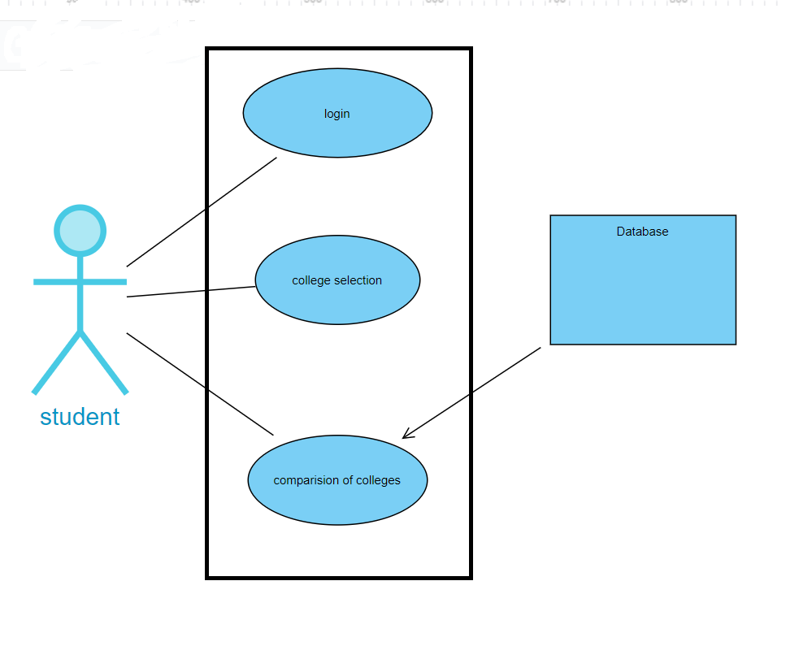
USE CASES:

Slide 9
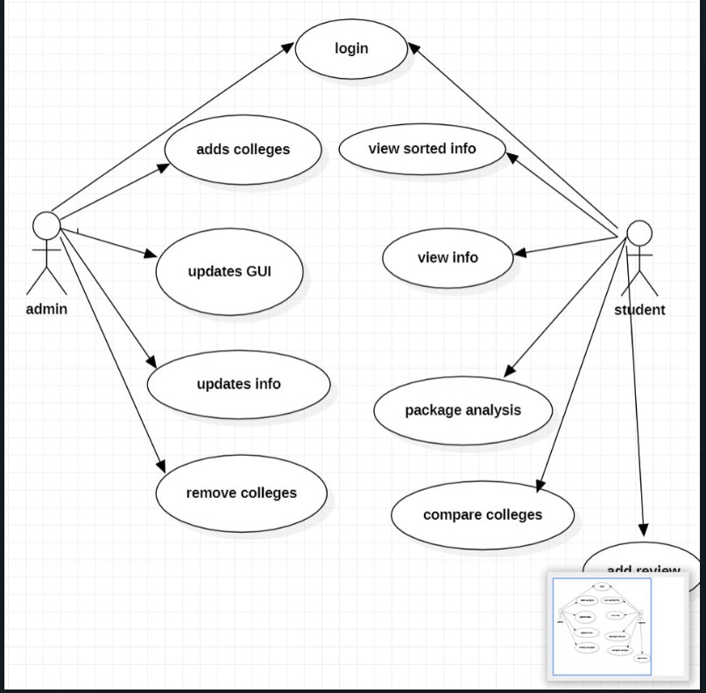
USE CASES:

Slide 10
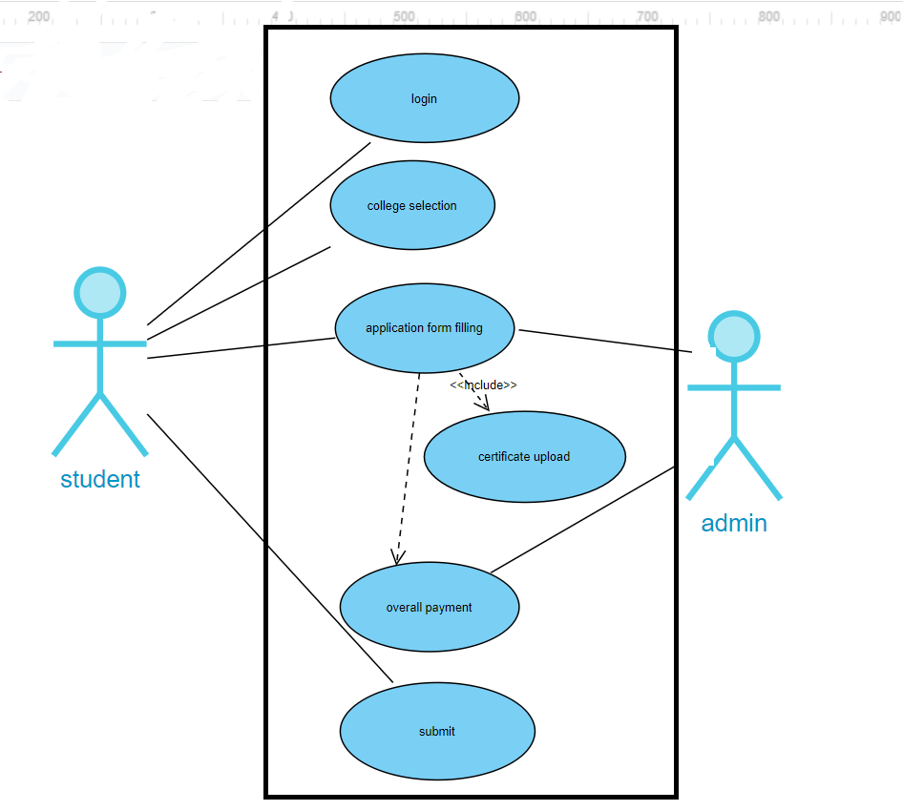
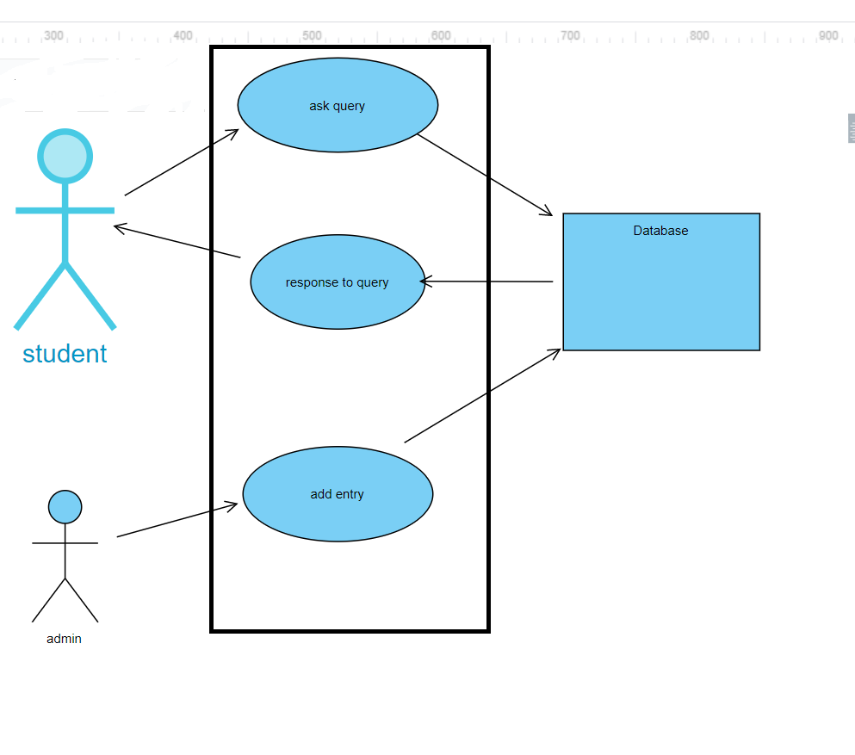
USE CASES:-

Slide 11

USE CASE 1:-
Use Case Name:-College Information
Actors:-User , System
Description:- To get the information about college which user want to know
Pre Condition:- College Selection
Post Condition:-Getting information about college by clicking
USER | SYSTEM
 | 1.List of colleges displayed
2.User clicks on the desirable college
 | 3.College information is Displayed

Slide 12
USE CASE 2:-
To Sort the colleges according to the rating or by the average salary .
Use Case Name:-College Information
Actors:-User , System
Description:- To sort the selected colleges
Pre Condition:- College Selection
Post Condition:-Getting information about college by clicking
USER | SYSTEM
1.Select desired colleges by checkbox
 | 2.Sorting according to salary
 | 3.Order is Displayed

Slide 13
USE CASE 3:-
To Provide a single application form for multiple colleges .
Use Case Name:-Single application form
Actors:- Student, admin
Description:- To avoid filling of same data multiple times.
Pre Condition:- College Selection
Post Condition:- application details
STUDENT | ADMIN
1.Select desired colleges by checkbox
 | 2. Application form is displayed
3. Registration Payment should be done

Slide 14
USE CASE 4:-
To provide assistance for user through chatbot .
Use Case Name:-Chatbot
Actors:-User , System
Description:- To respond to the queries
Pre Condition:- Asking questions
Post Condition:-Getting relevant information
USER | SYSTEM
1.Ask queries
 | 2.Categorize queries and relevant data is provided
3. Queries are cleared

Slide 15
USE CASE 5:-
To compare selected colleges using graphs .
Use Case Name:- Graph
Actors:-User , System
Description:- To display information graphically
Pre Condition:- college selection
Post Condition:-Displaying required data
USER | SYSTEM
1.Select colleges using checkbox
 | 2.Graphically data is shown
3.User can easily compare data among various colleges

Slide 16
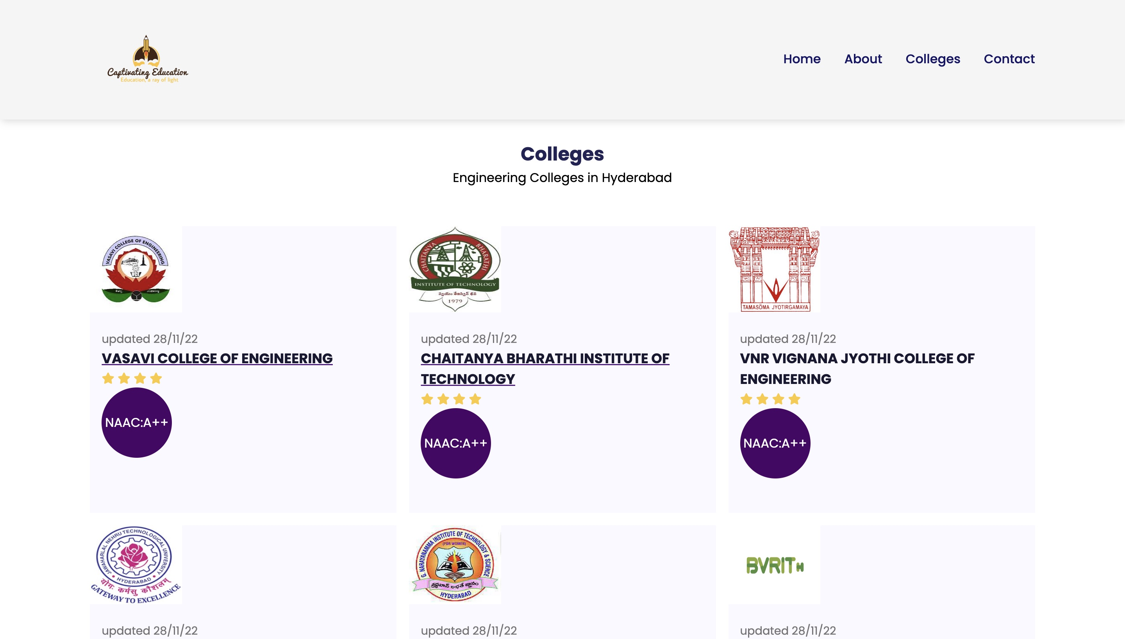
LIST OF COLLEGES:-

Slide 17
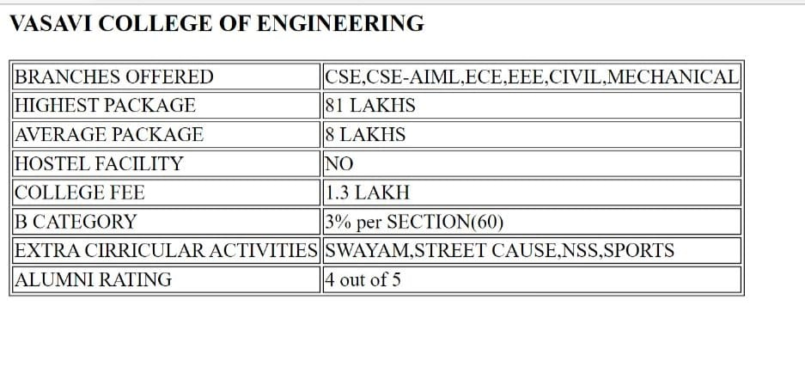
COLLEGE INFORMATION DISPLAY FORMAT :-

Slide 18
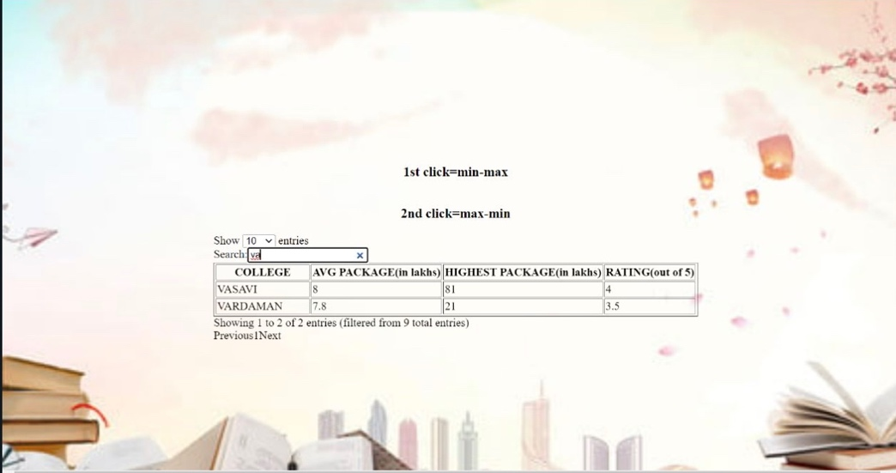
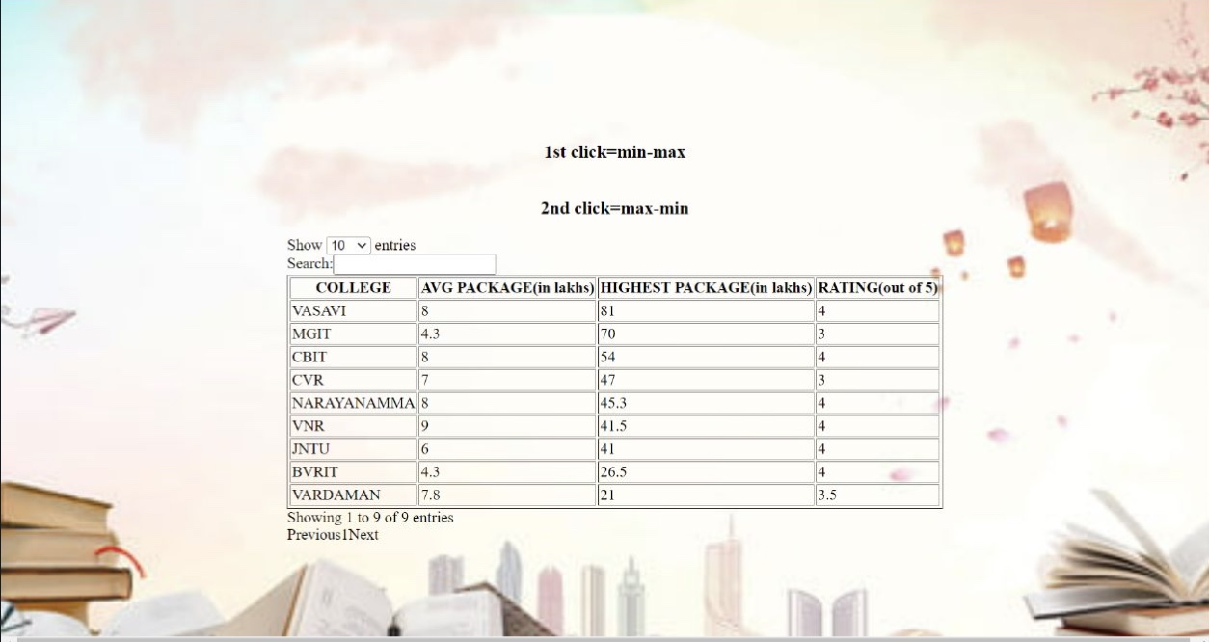
SEARCHING :-
SORTING:-

Slide 19
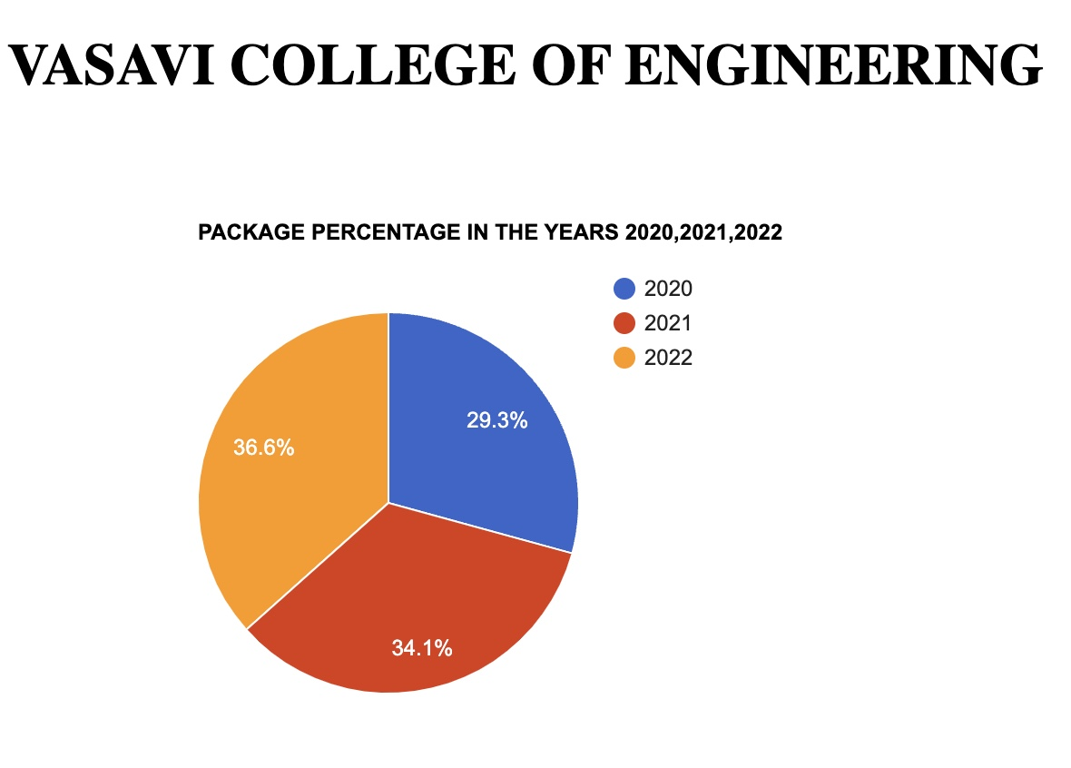
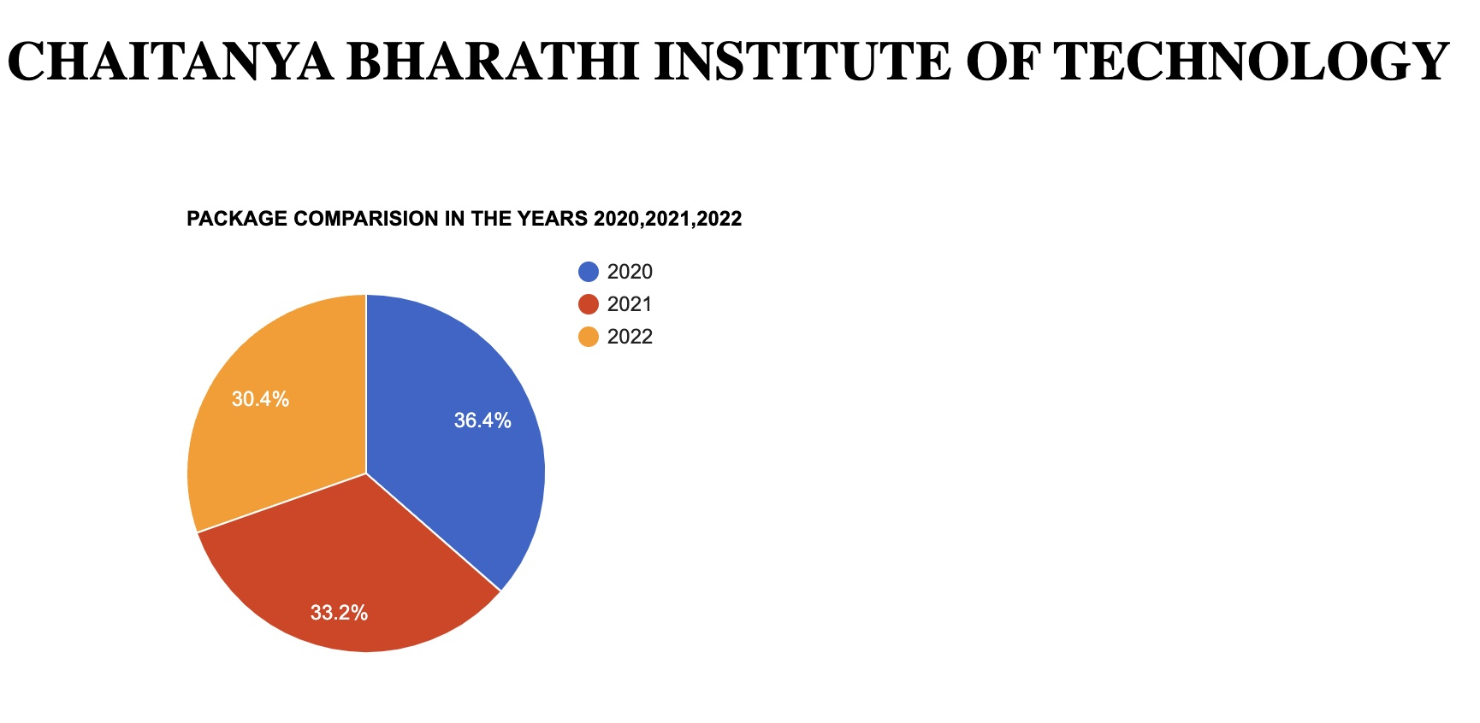
PIE CHARTS

Slide 20
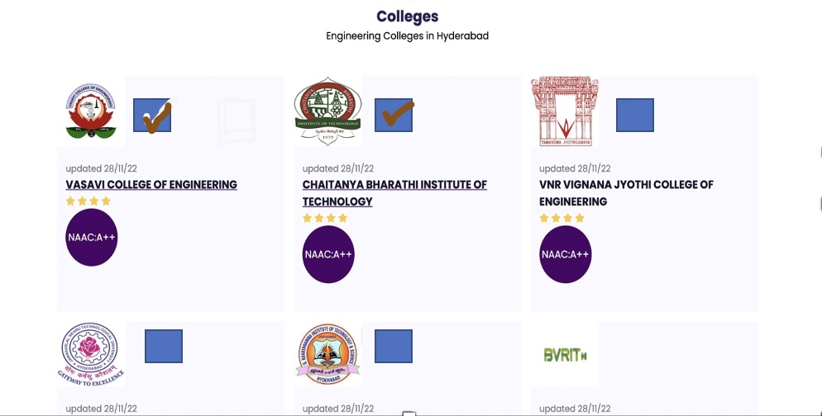
IMPLEMENTATION:-

Slide 21
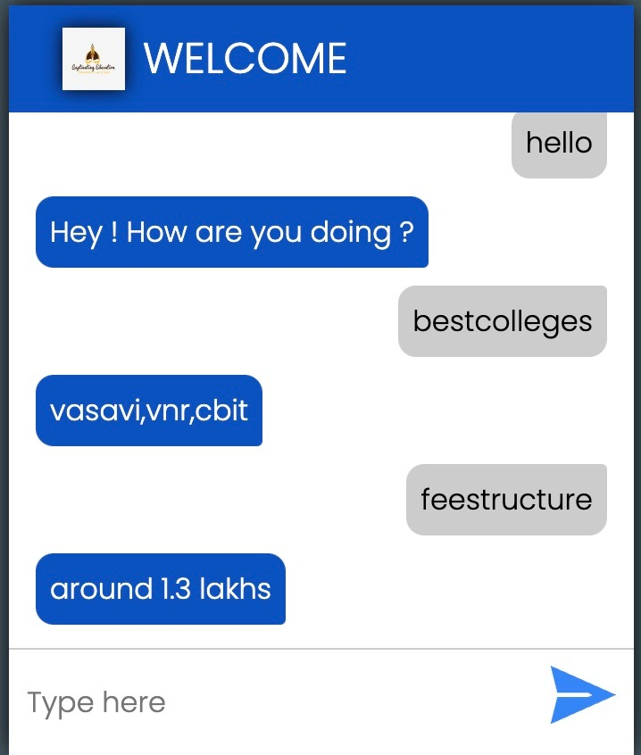
IMPLEMENTATION:-

Slide 22
To make the website Available for wide Range of Colleges. | To Enable the users interact with the Alumni of the Respective Colleges | To submit the b-cat applications by filling the form only once and by clicking on the colleges into which the user want to join rather than filling the same details multiple times.SSS
First Last

Slide 23
Thank you

